Slide 1




Excel
Training
for Beginners
SAID FAWZY
Manager of Information Center
Tendering Department
Arab Contractors

Slide 2


Excel
Training
for Beginners
SAID FAWZY
8
Managing
the Excel Workspace

Slide 3






90%
90%
Exploring Workbook Views
Using Zoom in a Worksheet
Arranging Workbooks
Freezing Panes
Exam 8: Excel Workspace

Slide 4
Excel
Training
for Beginners
SAID FAWZY
Exploring Workbook Views
1

Slide 5
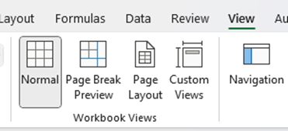
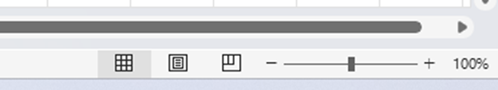
Exploring Workbook Views
How to know which view you are in?

Slide 6
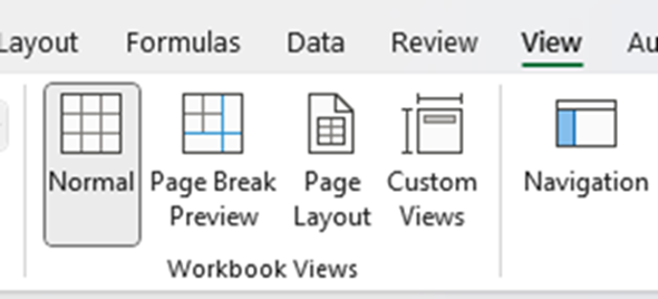
Exploring Workbook Views
Normal View

Slide 7
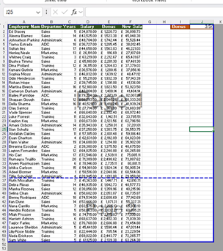
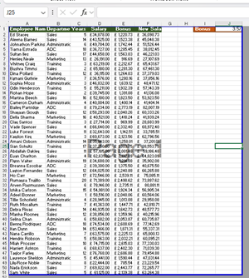
Exploring Workbook Views
Page Break View

Slide 8
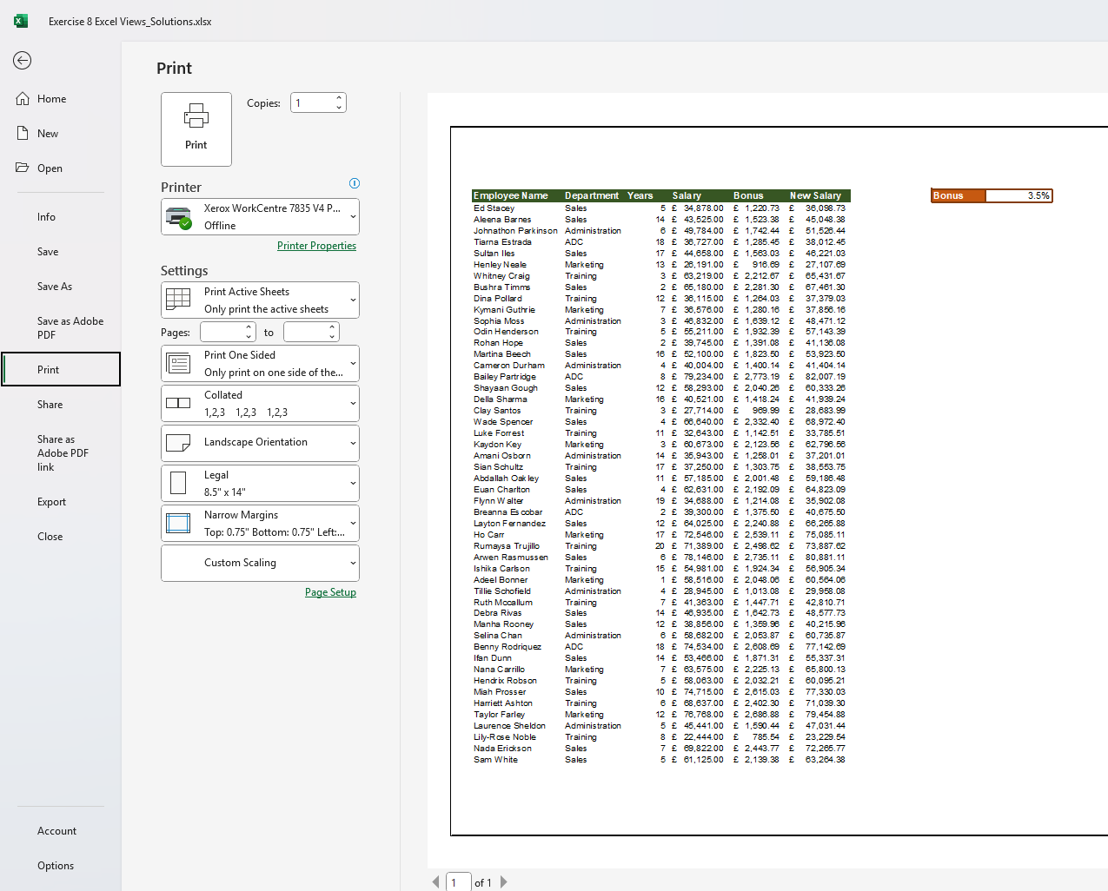

Exploring Workbook Views
Print Preview

Slide 9
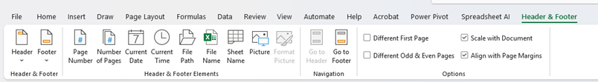
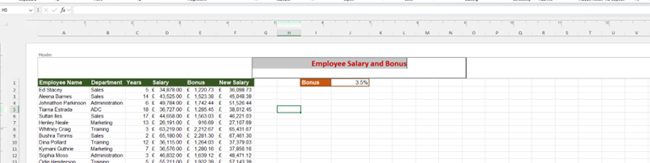
Exploring Workbook Views
Page Layout
Zoom Slider

Slide 10
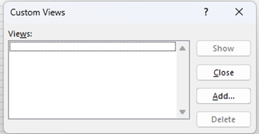
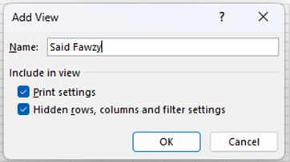
Exploring Workbook Views
Custom View

Slide 11
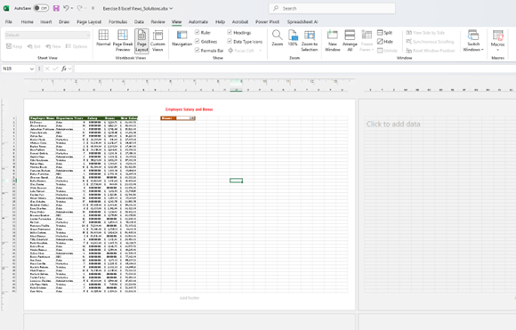
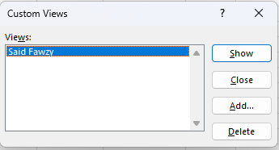
Exploring Workbook Views
Custom View

Slide 12
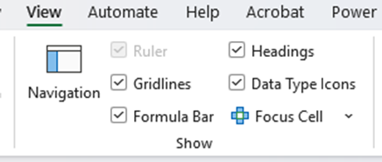
Exploring Workbook Views
Show Group

Slide 13
Excel
Training
for Beginners
SAID FAWZY
Using Zoom in
a Worksheet
2

Slide 14

Using Zoom in a Worksheet
Using Mouse Wheel

Slide 15
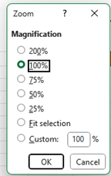

Using Zoom in a Worksheet
Zoom Slider

Slide 16
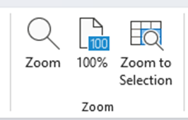
Using Zoom in a Worksheet
Zoom Group
Zoom

Slide 17
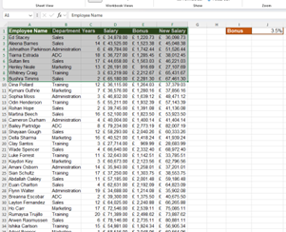
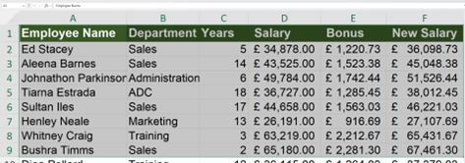
Using Zoom in a Worksheet
Fit Selection

Slide 18
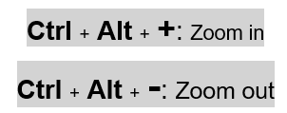
Using Zoom in a Worksheet
Using Shortcut keys

Slide 19
Excel
Training
for Beginners
SAID FAWZY
3
Arranging Workbooks

Slide 20
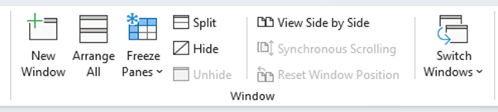
Arranging Workbooks
Window Group

Slide 21
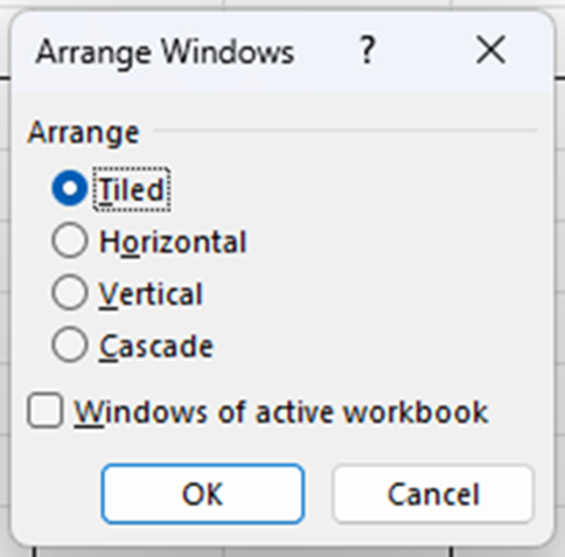
Arranging Workbooks
Window Group

Slide 22
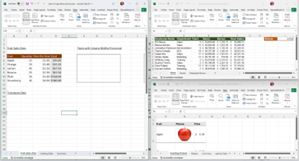
Arranging Workbooks
Window Group

Slide 23
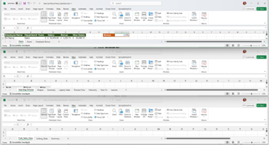
Arranging Workbooks
Window Group

Slide 24
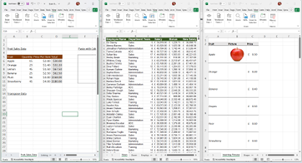
Arranging Workbooks
Window Group

Slide 25
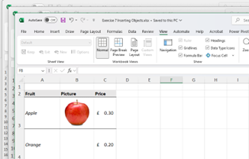
Arranging Workbooks
Window Group

Slide 26
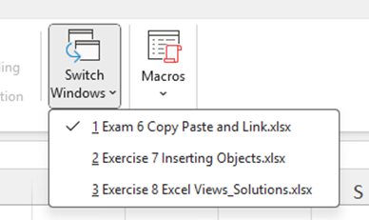
Arranging Workbooks
Switch Windows

Slide 27
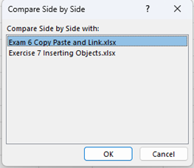
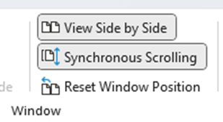
Arranging Workbooks
View Side by Side

Slide 28
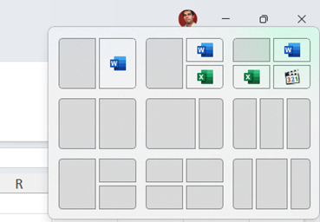
Arranging Workbooks
Using Windows Snaping

Slide 29
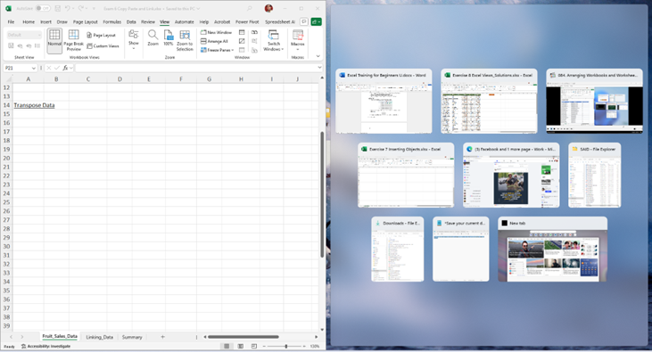

Arranging Workbooks
Using Windows Snaping

Slide 30
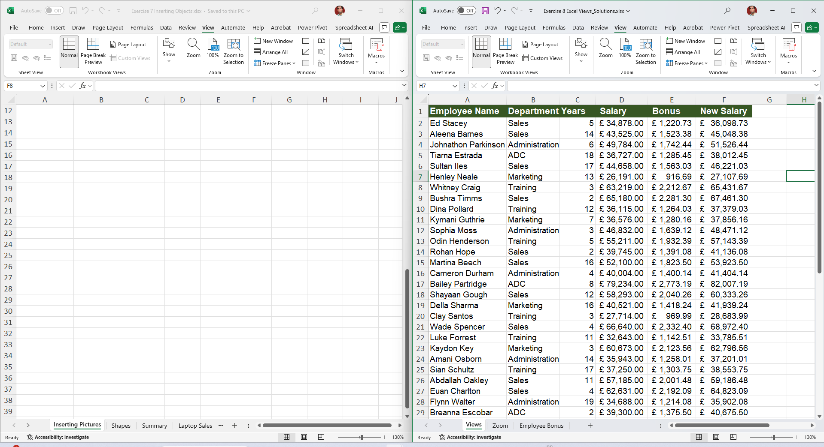
Arranging Workbooks
Using Windows Snaping

Slide 31
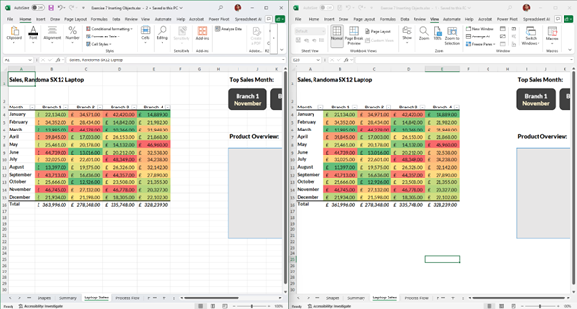


Arranging Workbooks
New Window

Slide 32
Arranging Workbooks
New Window

Slide 33
Excel
Training
for Beginners
SAID FAWZY
4
Freezing Panes

Slide 34
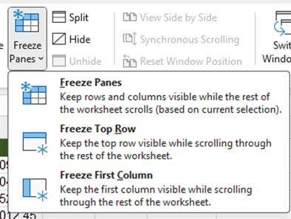

Freezing Panes
Freeze Panes

Slide 35
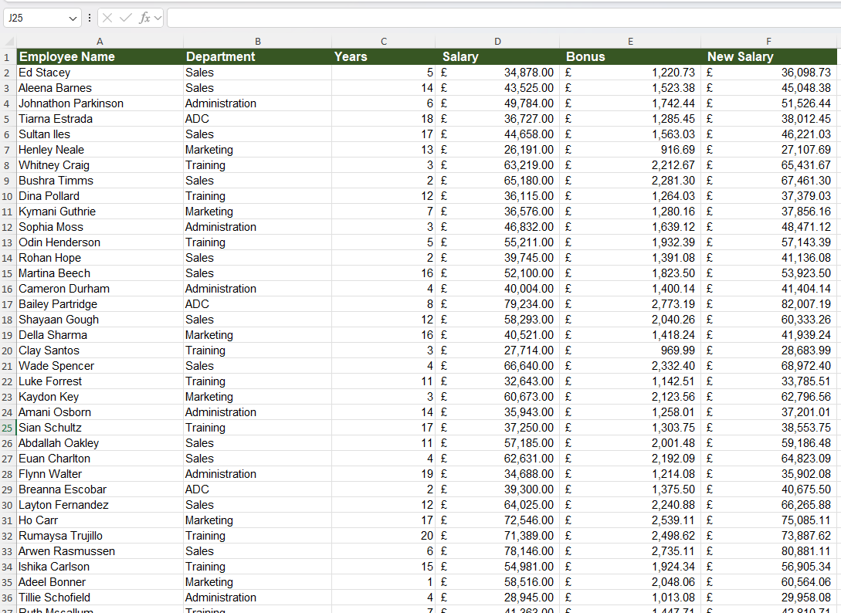
Freezing Panes
Freeze Panes

Slide 36
Freezing Panes
Freeze Panes

Slide 37
Freezing Panes
Freeze Panes

Slide 38
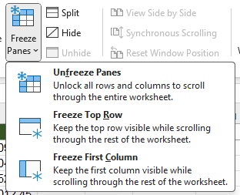
Freezing Panes
UnFreeze Panes

Slide 39
Freezing Panes
Split

Slide 40
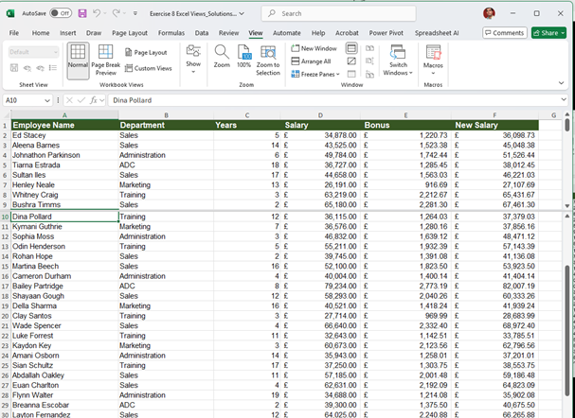
Freezing Panes
Freeze Panes

Slide 41
Excel
Training
for Beginners
SAID FAWZY
Exam 8
Excel Workspace

Slide 42
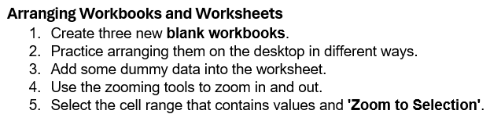
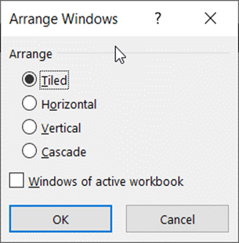
Exam 8: Excel Workspace

Slide 43
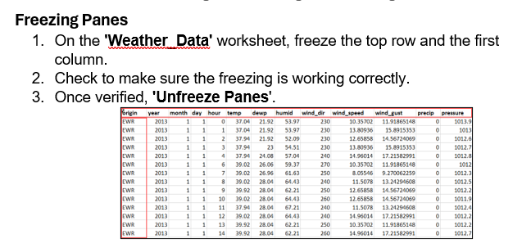
Exam 8: Excel Workspace

Slide 44



